Slide 1


Azərbaycan Dövlət Neft və Sənaye Universiteti
Calculus
Single Variable

Slide 2
Applications of Integration

Slide 3
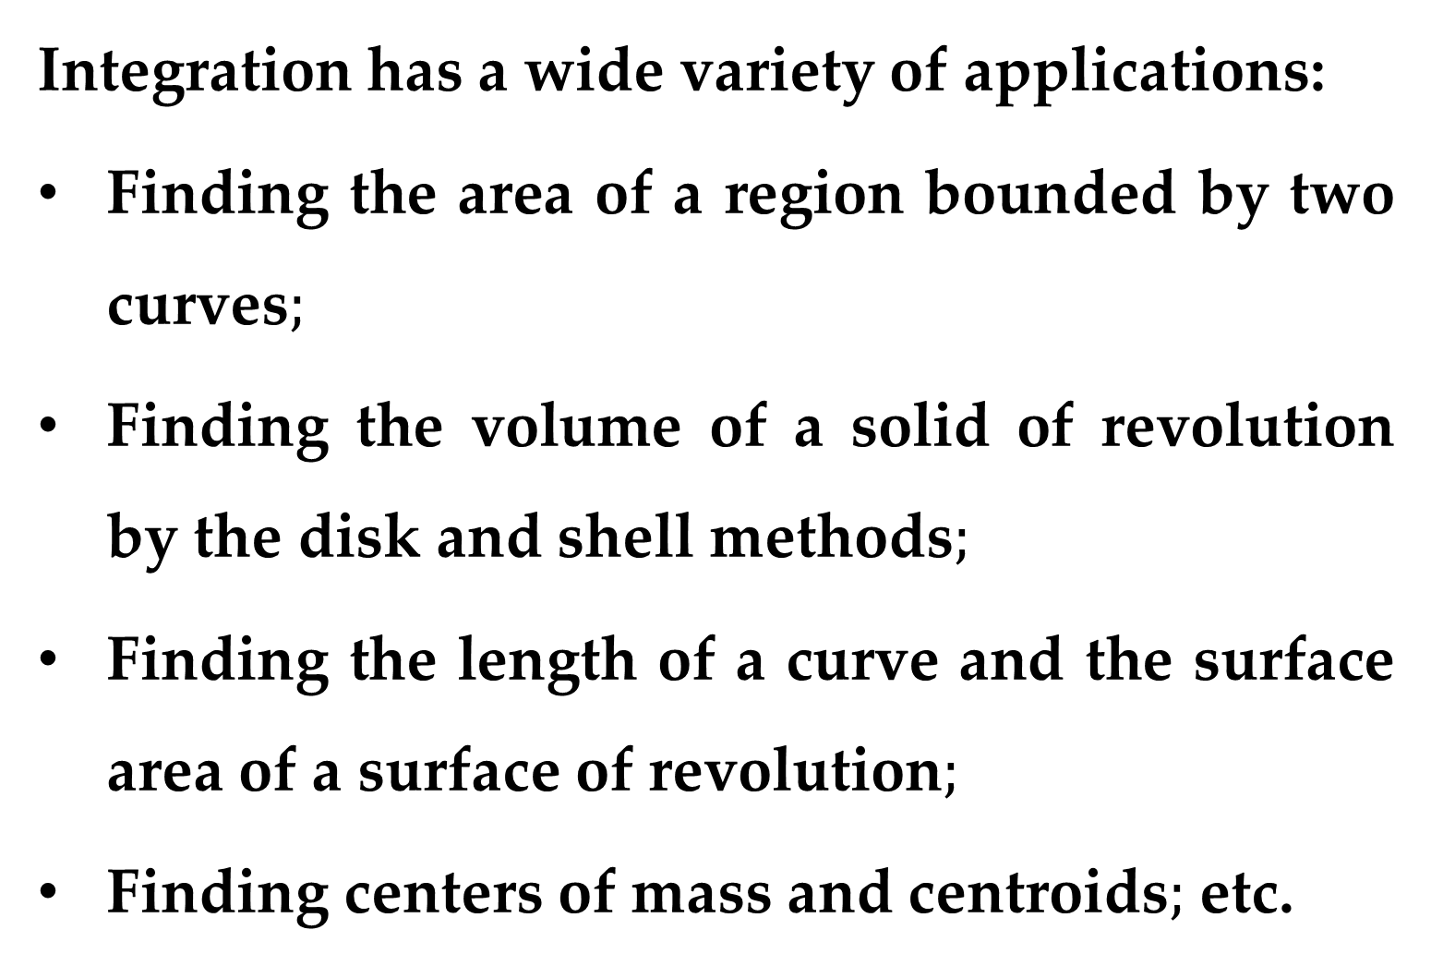
Integration has a wide variety of applications:
Finding the area of a region bounded by two curves$;$
Finding the volume of a solid of revolution by the disk and shell methods$;$
Finding the length of a curve and the surface area of a surface of revolution$;$
Finding centers of mass and centroids$;$ etc.

Slide 4
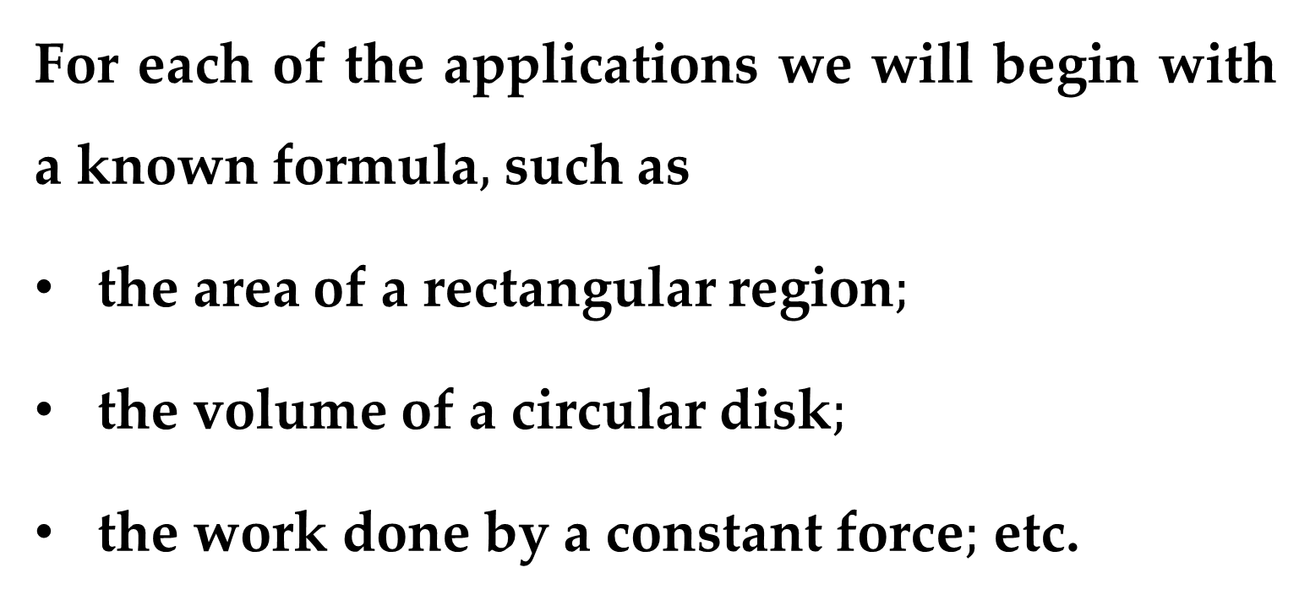
For each of the applications we will begin with a known formula$,$ such as
the area of a rectangular region$;$
the volume of a circular disk$;$
the work done by a constant force$;$ etc.
Then we will learn how the limit of a sum gives rise to new formulas that involve integration.

Slide 5
Applications of Integration:
Area of a Region Between Two Curves

Slide 6
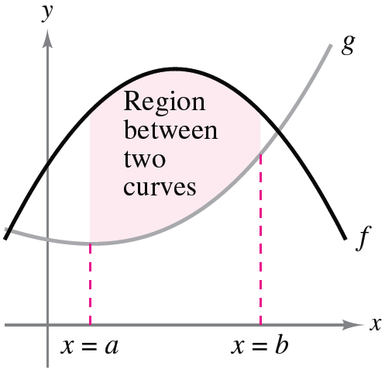
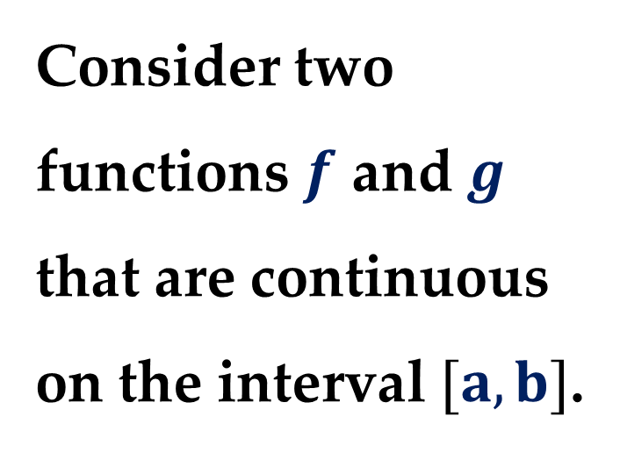
With a few modifications, we can extend the application of definite integrals from the area of a region under a curve to the area of a region between two curves.
Consider two functions $f$ and $g$ that are continuous on the interval $[a,b]$.

Slide 7
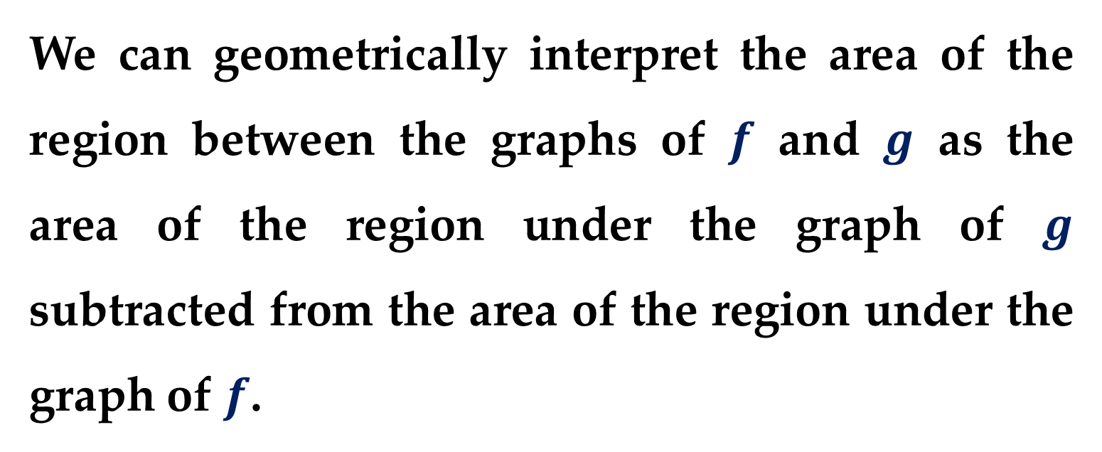
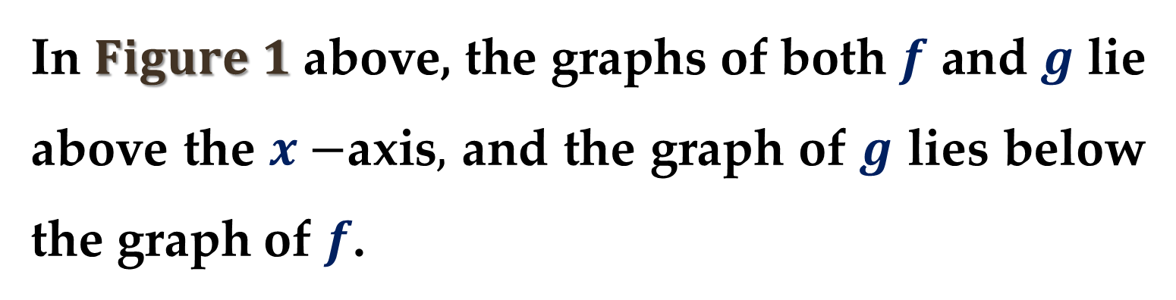
In $Figure 1$ above, the graphs of both $f$ and $g$ lie above the $x−$axis$,$ and the graph of $g$ lies below the graph of $f$.
We can geometrically interpret the area of the region between the graphs of $f$ and $g$ as the area of the region under the graph of $g$ subtracted from the area of the region under the graph of $f$.

Slide 8
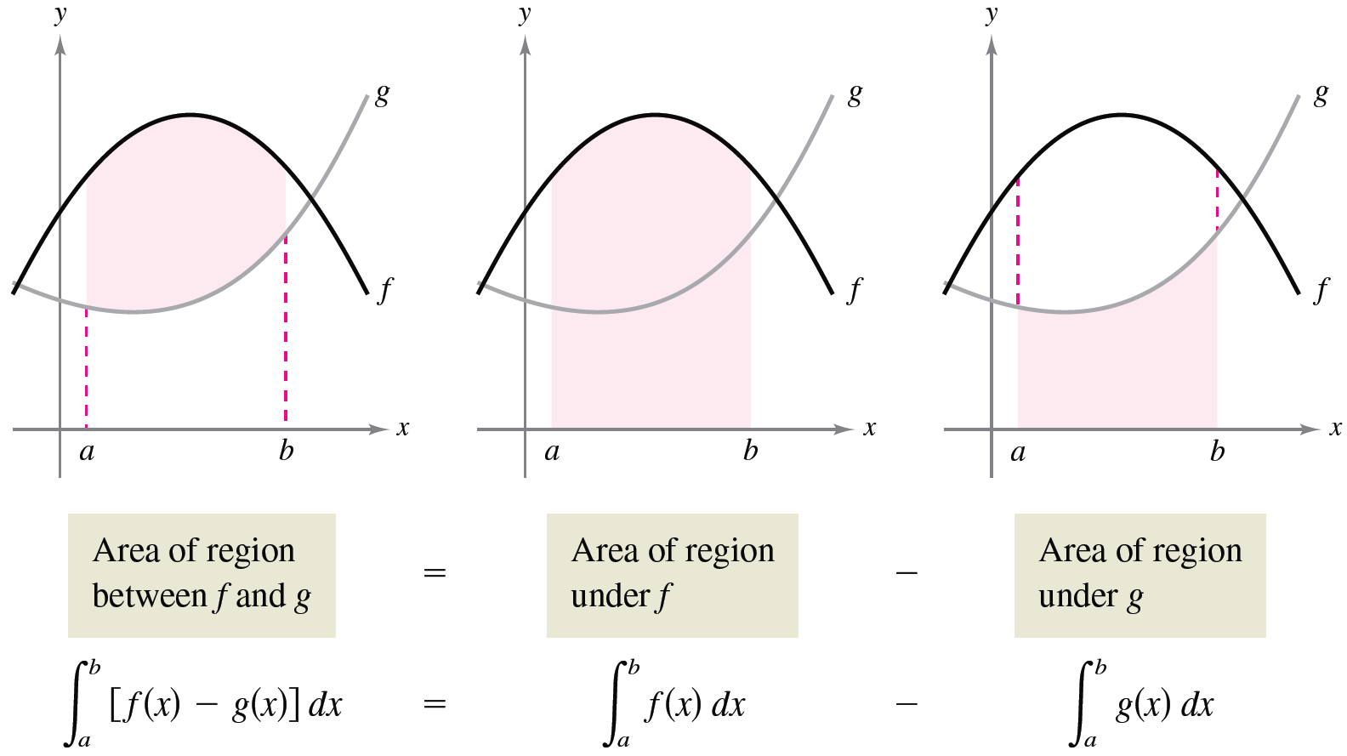

This concept is shown in $Figure 2$.

Slide 9
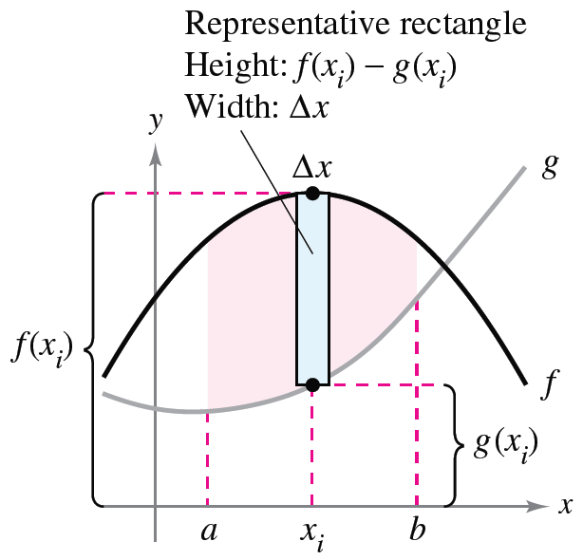
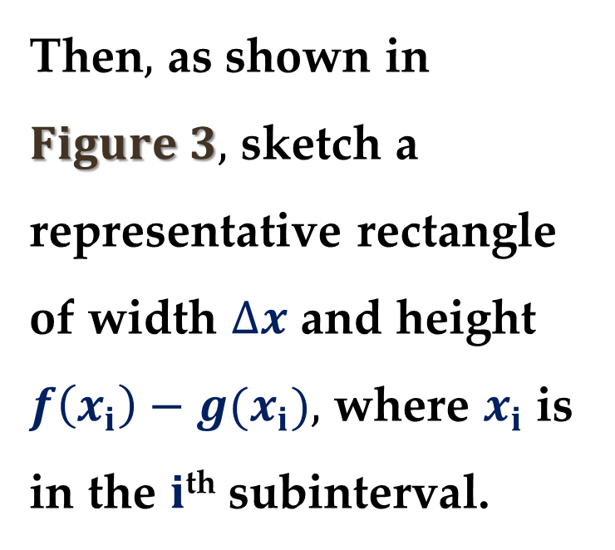
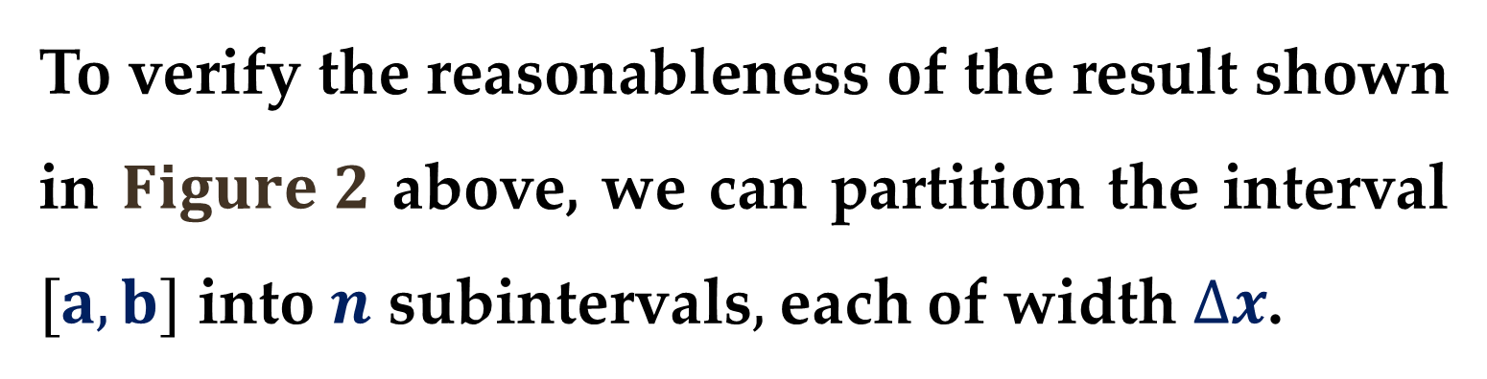
To verify the reasonableness of the result shown in $Figure 2$ above, we can partition the interval $[a,b]$ into $n$ subintervals$,$ each of width $∆x$.
Then$,$ as shown in $Figure 3,$ sketch a representative rectangle of width $∆x$ and height $f\left(x_{i}\right)−g(x_{i}),$ where $x_{i}$ is in the $i$^{th} subinterval.

Slide 10
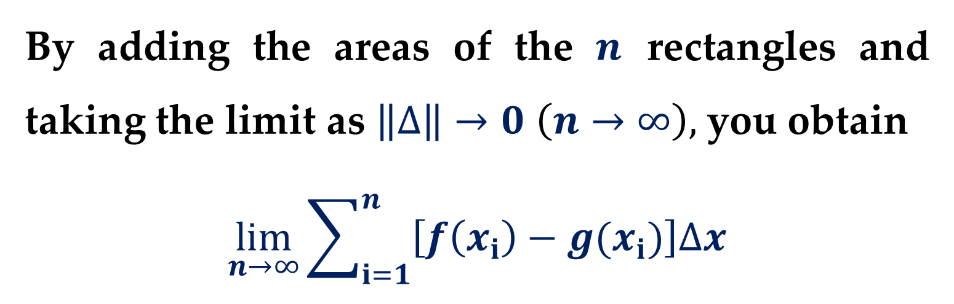
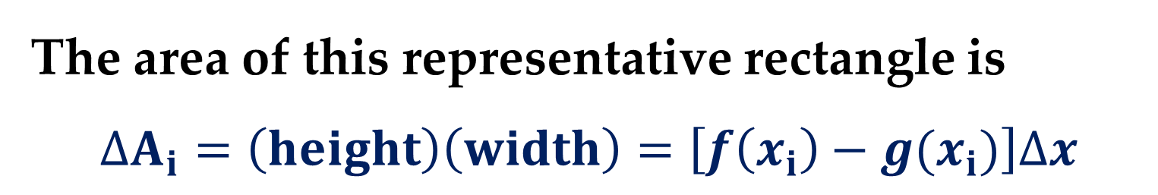
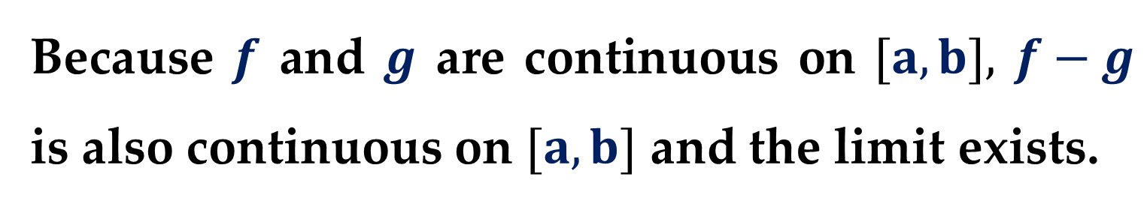
The area of this representative rectangle is
$$∆A_{i}=\left(height\right)\left(width\right)=\left[f\left(x_{i}\right)−g(x_{i})\right]∆x$$
By adding the areas of the $n$ rectangles and taking the limit as $\left\|∆\right\|→0$ $\left(n→∞\right),$ you obtain
$$\lim_{n→∞}{\sum_{i=1}^{n}{\left[f\left(x_{i}\right)−g(x_{i})\right]∆x}}$$
Because $f$ and $g$ are continuous on $[a,b],$ $f−g$ is also continuous on $[a,b]$ and the limit exists.

Slide 11
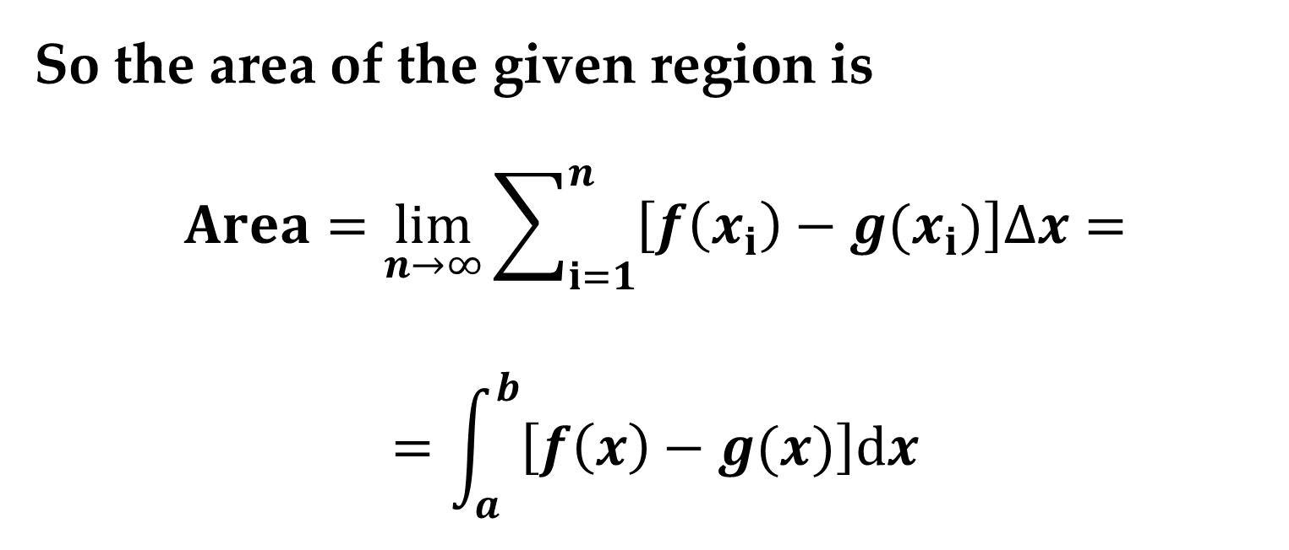
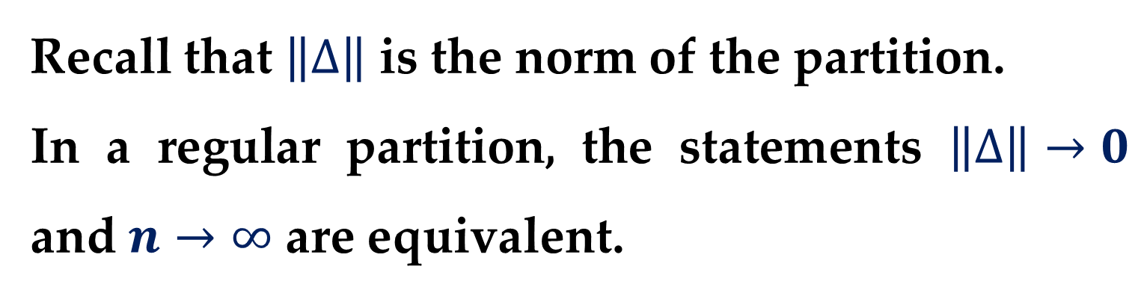
Recall that $\left\|∆\right\|$ is the norm of the partition.
In a regular partition, the statements $\left\|∆\right\|→0$ and $n→∞$ are equivalent.
So the area of the given region is
$$Area=\lim_{n→∞}{\sum_{i=1}^{n}{\left[f\left(x_{i}\right)−g(x_{i})\right]∆x}}=$$
$$=\int_{a}^{b}{\left[f\left(x\right)−g(x)\right]dx}$$

Slide 12
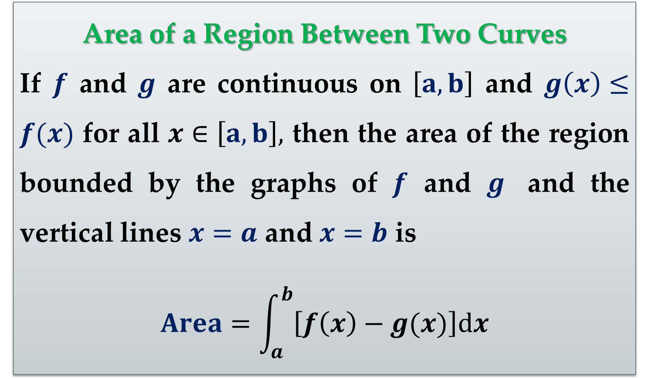
Area of a Region Between Two Curves
If $f$ and $g$ are continuous on $\left[a,b\right]$ and $g\left(x\right)≤f(x)$ for all $x∈\left[a,b\right],$ then the area of the region bounded by the graphs of $f$ and $g$ and the vertical lines $x=a$ and $x=b$ is
$$Area=\int_{a}^{b}{\left[f\left(x\right)−g(x)\right]dx}$$

Slide 13
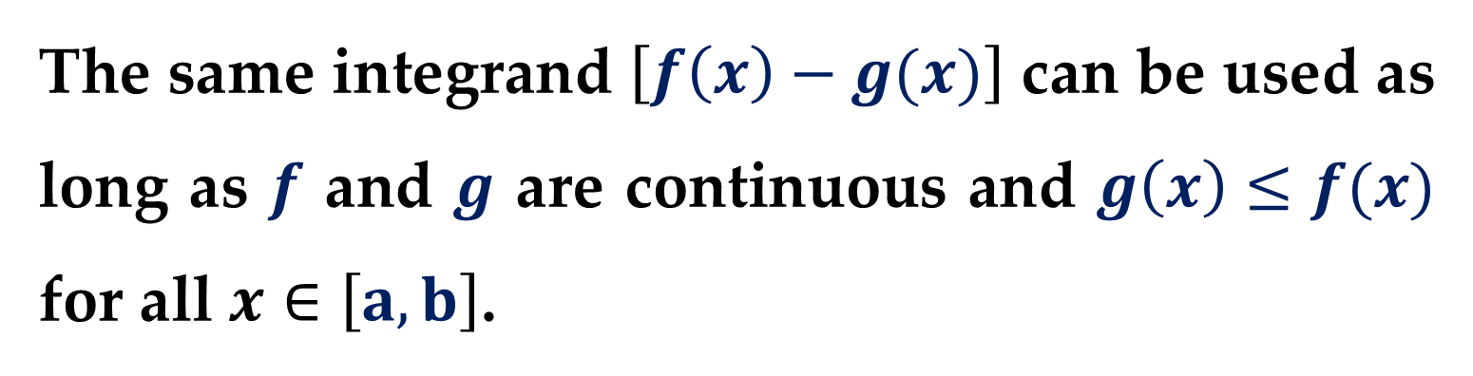
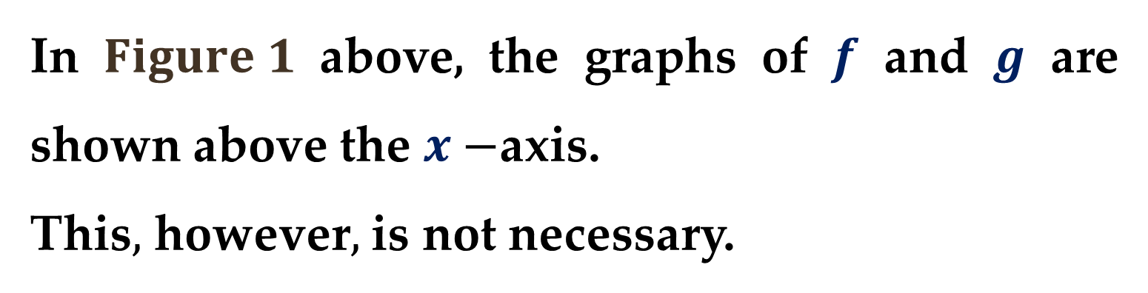
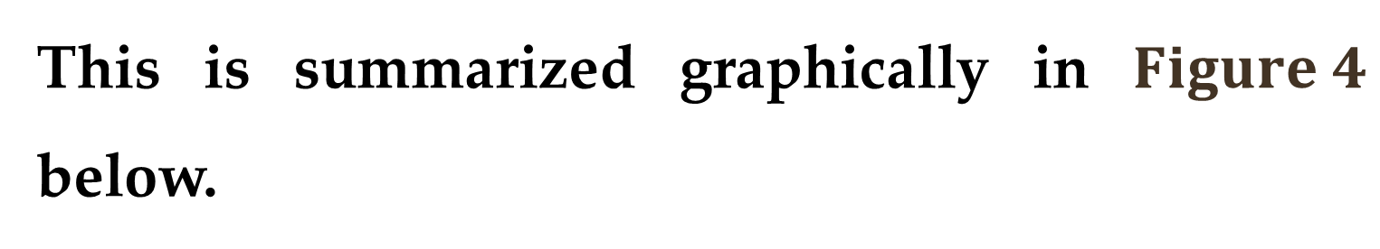
In $Figure 1$ above, the graphs of $f$ and $g$ are shown above the $x−$axis.
This$,$ however$,$ is not necessary.
The same integrand $\left[f\left(x\right)−g(x)\right]$ can be used as long as $f$ and $g$ are continuous and $g\left(x\right)≤f(x)$ for all $x∈\left[a,b\right]$.
This is summarized graphically in $Figure 4$ below.

Slide 14
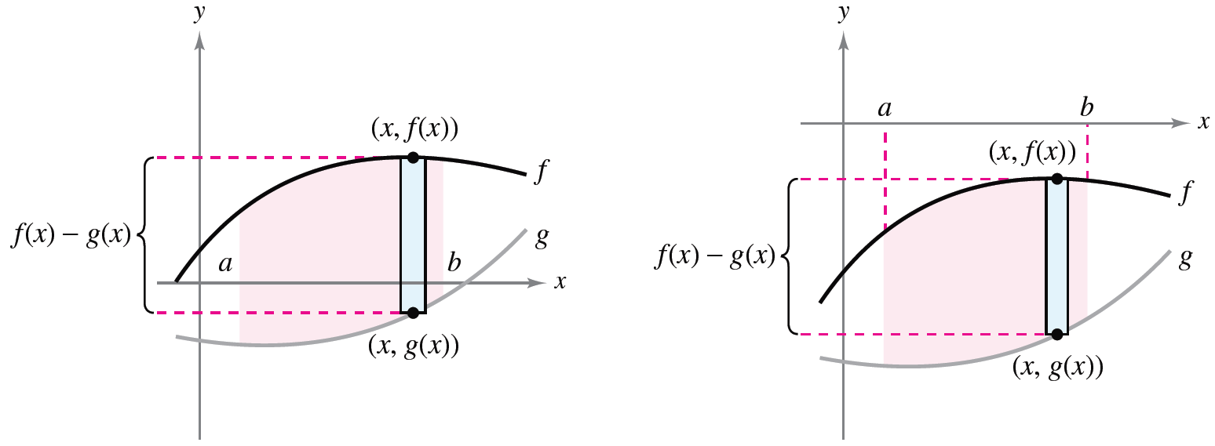
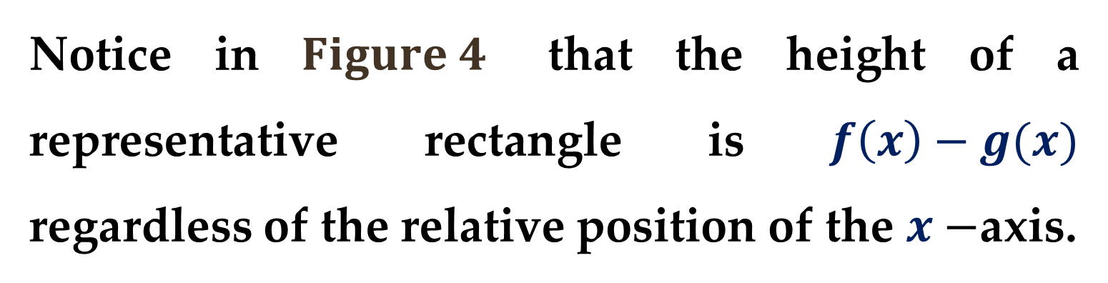
Notice in $Figure 4$ that the height of a representative rectangle is $f\left(x\right)−g(x)$ regardless of the relative position of the $x−$axis.

Slide 15
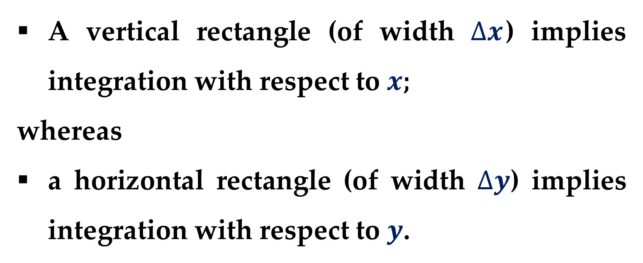
Representative rectangles are used throughout in this course in various applications of integration.
A vertical rectangle (of width $∆x$) implies integration with respect to $x$;
whereas
a horizontal rectangle (of width $∆y$) implies integration with respect to $y$.

Slide 16
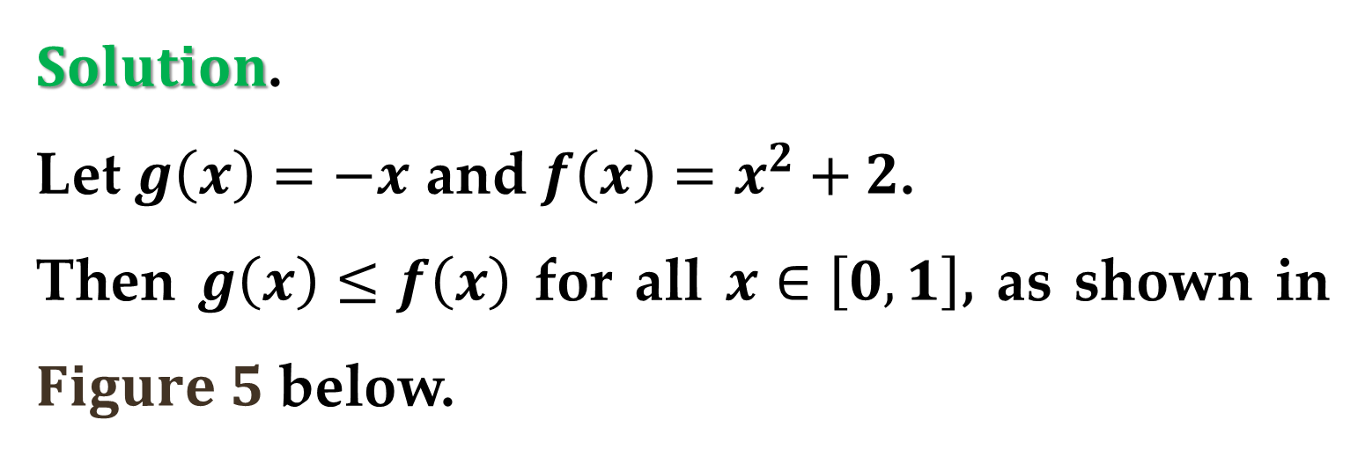
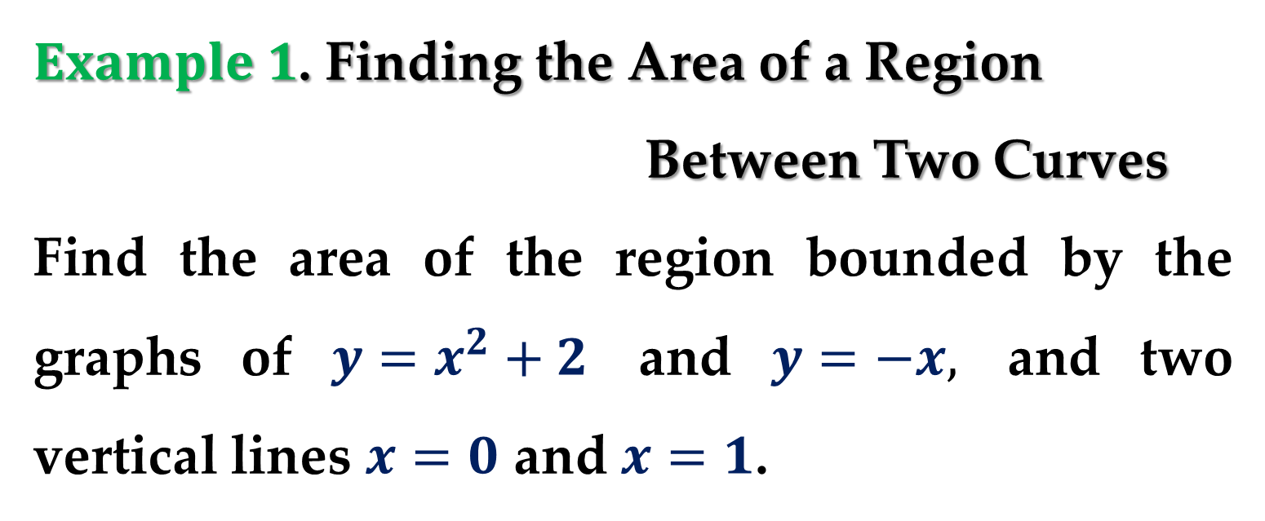
$Example 1$. Finding the Area of a Region
Between Two Curves
Find the area of the region bounded by the graphs of $y=x^{2}+2$ and $y=−x,$ and two vertical lines $x=0$ and $x=1$.
$Solution$.
Let $g\left(x\right)=−x$ and $f\left(x\right)=x^{2}+2$.
Then $g\left(x\right)≤f\left(x\right)$ for all $x∈\left[0,1\right]$, as shown in $Figure 5$ below.

Slide 17
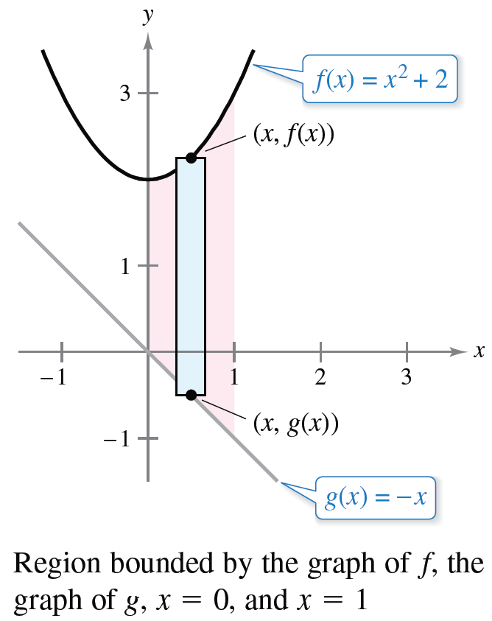
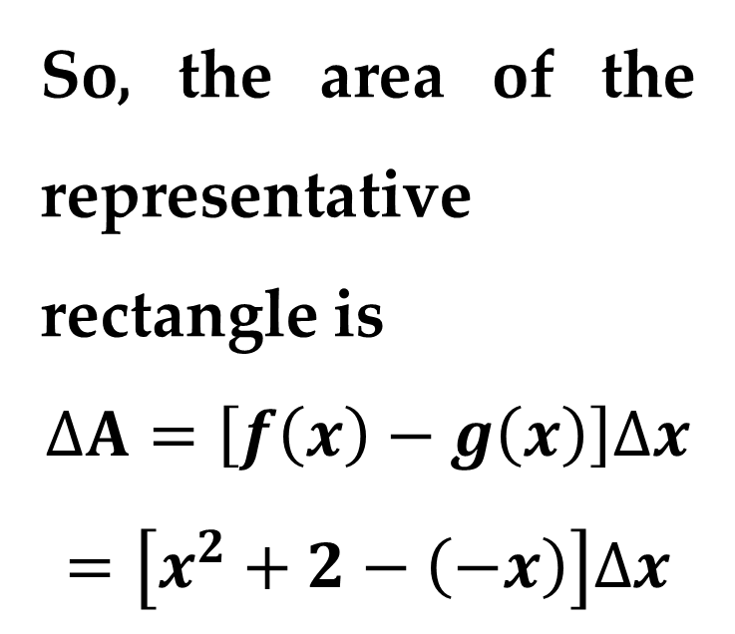
$$Solution (continued)$$
So, the area of the representative rectangle is
$$∆A=\left[f\left(x\right)−g\left(x\right)\right]∆x$$
$$=\left[x^{2}+2−\left(−x\right)\right]∆x$$

Slide 18
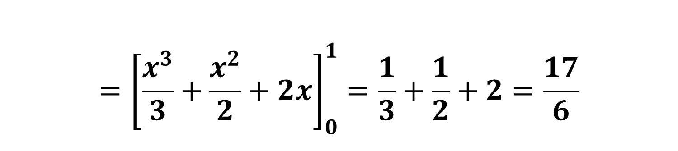
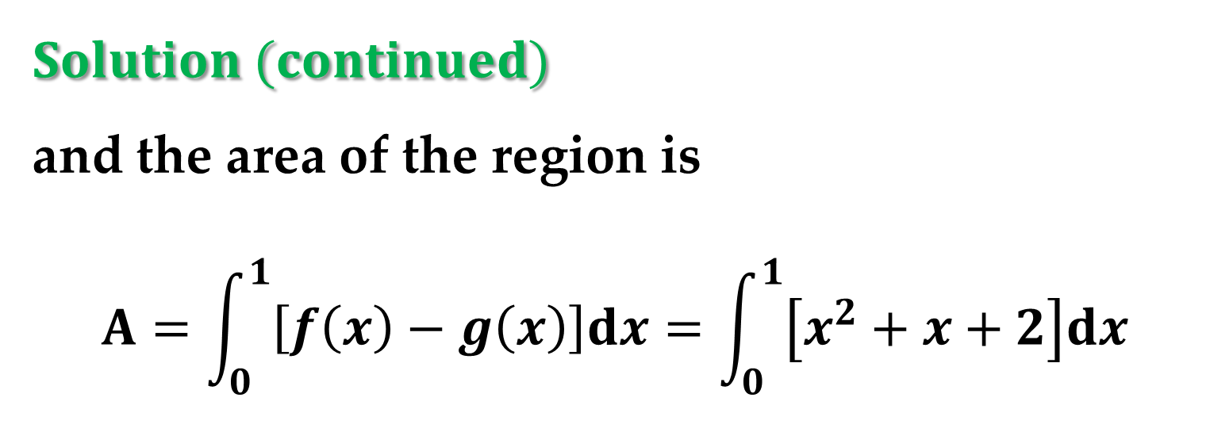
$$Solution (continued)$$
and the area of the region is
$$A=\int_{0}^{1}{\left[f\left(x\right)−g\left(x\right)\right]dx}=\int_{0}^{1}{\left[x^{2}+x+2\right]dx}$$
$$={\left[\frac{x^{3}}{3}+\frac{x^{2}}{2}+2x\right]}_{0}^{1}=\frac{1}{3}+\frac{1}{2}+2=\frac{17}{6}$$

Slide 19
Applications of Integration:
Area of a Region Between Intersecting Curves

Slide 20
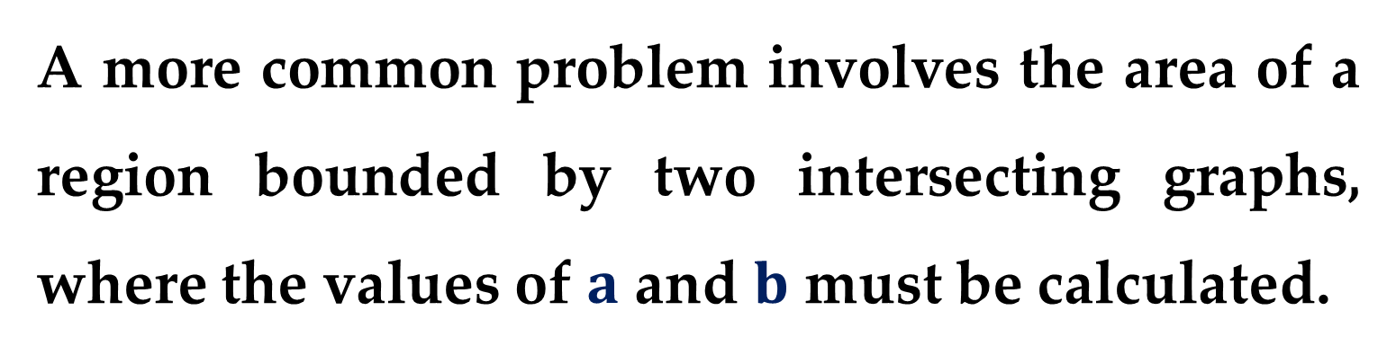
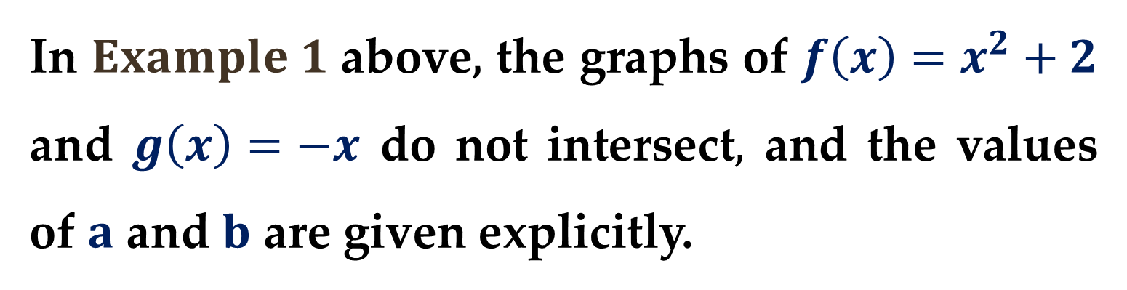
In $Example 1$ above, the graphs of $f\left(x\right)=x^{2}+2$ and $g\left(x\right)=−x$ do not intersect$,$ and the values of $a$ and $b$ are given explicitly.
A more common problem involves the area of a region bounded by two intersecting graphs, where the values of $a$ and $b$ must be calculated.
This technique is illustrated in the following Example.

Slide 21
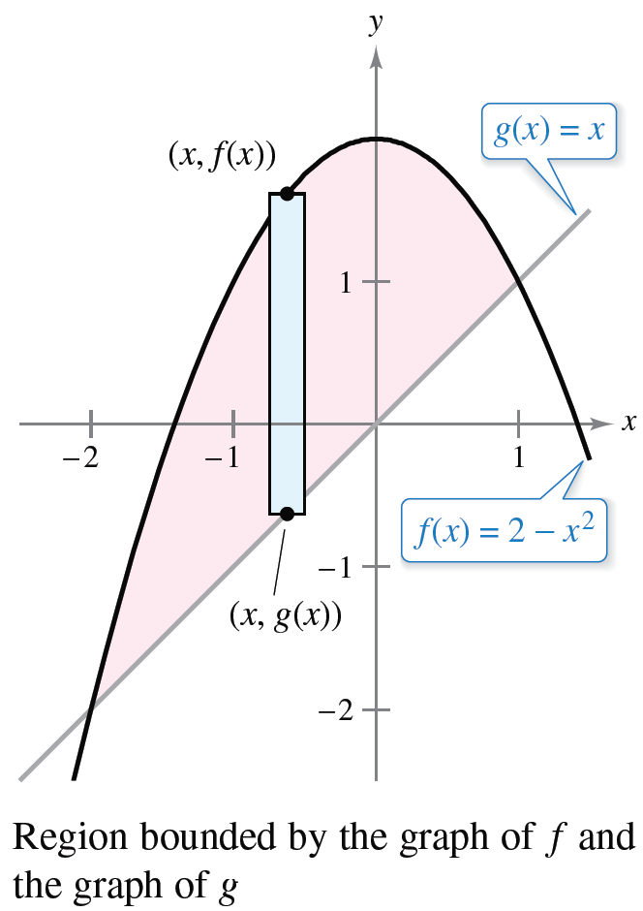
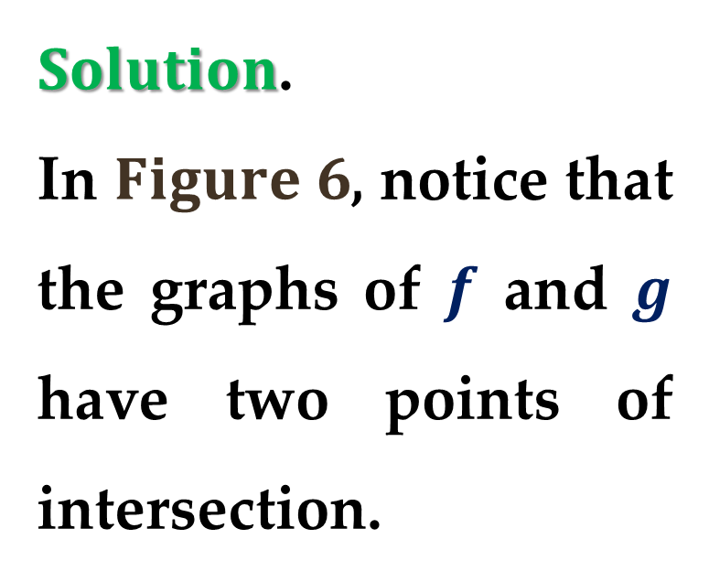
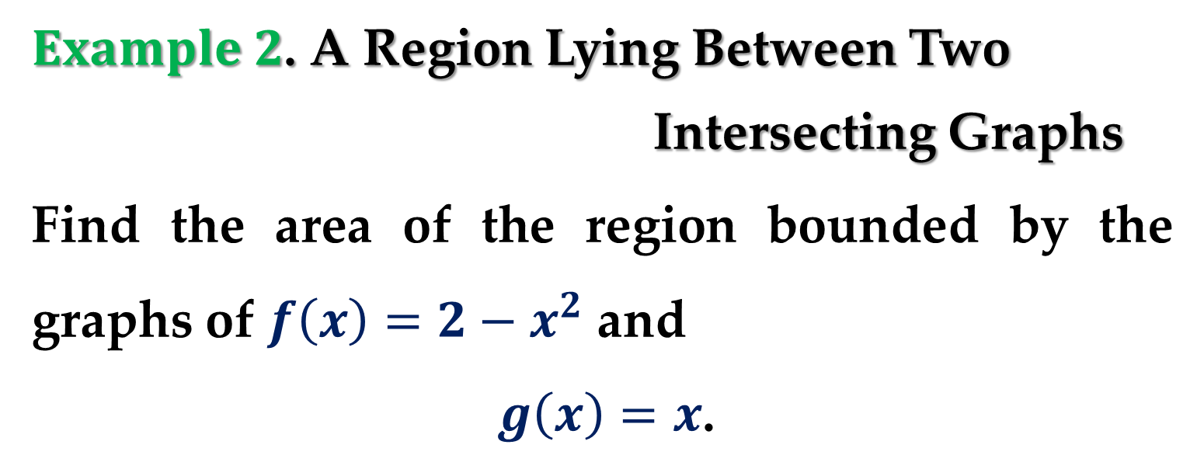
$Example 2$. A Region Lying Between Two
Intersecting Graphs
Find the area of the region bounded by the graphs of $f\left(x\right)=2−x^{2}$ and
$g\left(x\right)=x$.
$Solution$.
In $Figure 6$, notice that the graphs of $f$ and $g$ have two points of intersection.

Slide 22
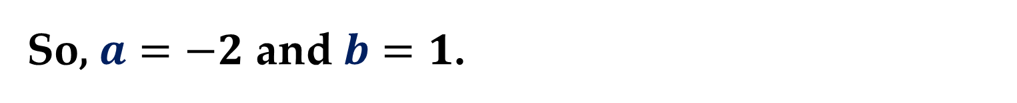
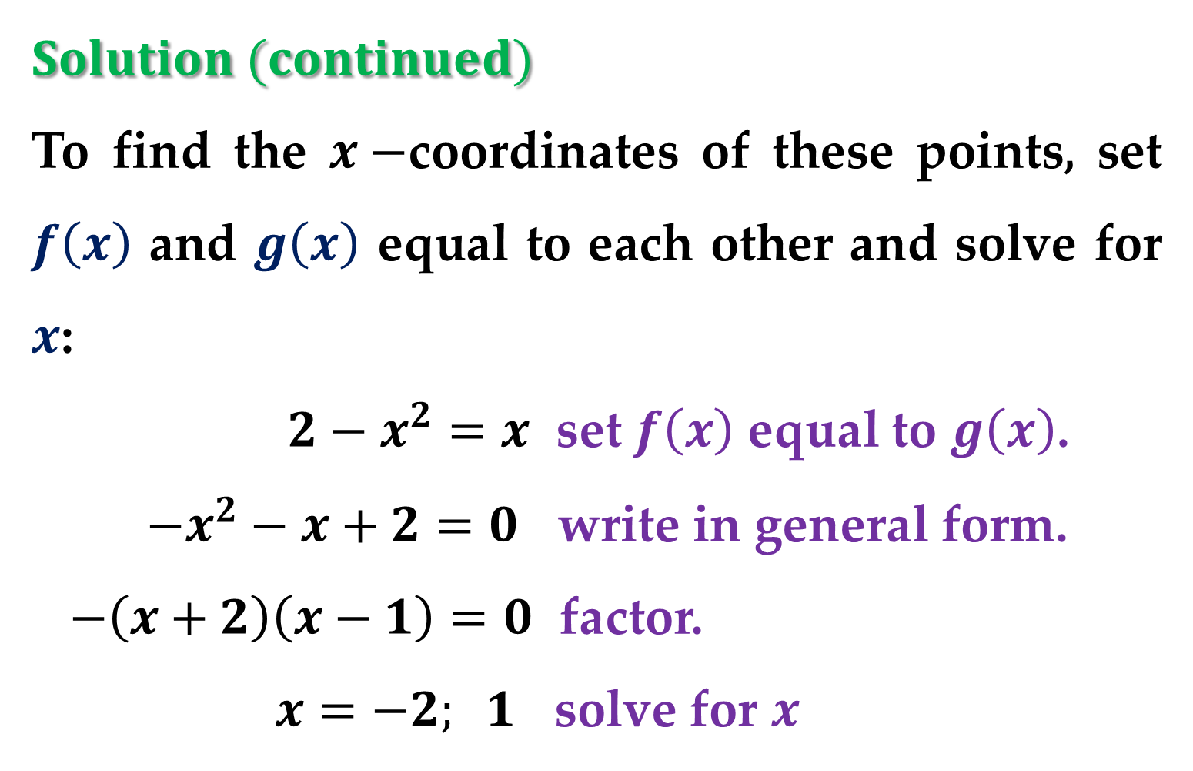
$$Solution (continued)$$
To find the $x−$coordinates of these points, set $f\left(x\right)$ and $g\left(x\right)$ equal to each other and solve for $x$:
$2−x^{2}=x$ set $f\left(x\right)$ equal to $g\left(x\right)$.
$−x^{2}−x+2=0$ write in general form.
$−\left(x+2\right)\left(x−1\right)=0$ factor.
$x=−2; 1$ solve for $x$
So, $a=−2$ and $b=1$.

Slide 23
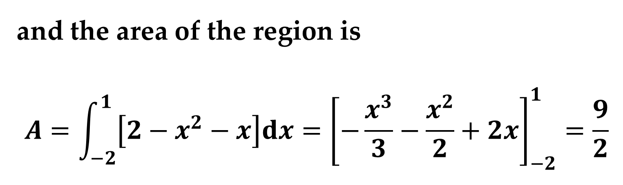
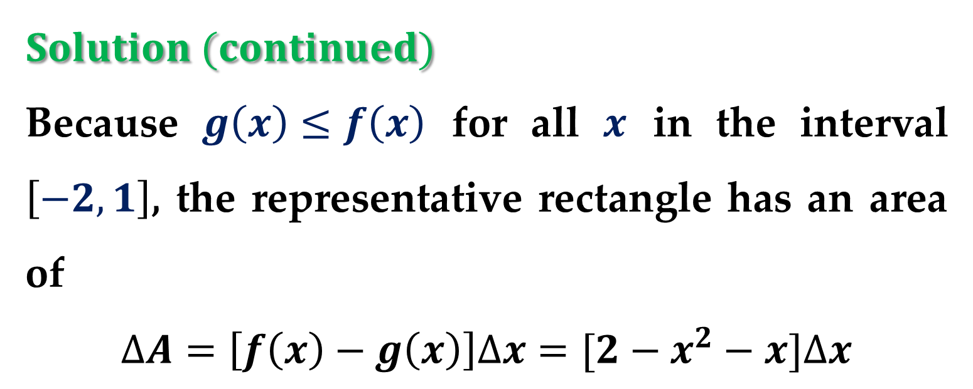
$$Solution (continued)$$
Because $g\left(x\right)≤f\left(x\right)$ for all $x$ in the interval $\left[−2, 1\right]$, the representative rectangle has an area of
$$∆A=\left[f\left(x\right)−g\left(x\right)\right]∆x=[2−x^{2}−x]∆x$$
and the area of the region is
$$A=\int_{−2}^{1}{\left[2−x^{2}−x\right]dx}={\left[−\frac{x^{3}}{3}−\frac{x^{2}}{2}+2x\right]}_{−2}^{1}=\frac{9}{2}$$

Slide 24
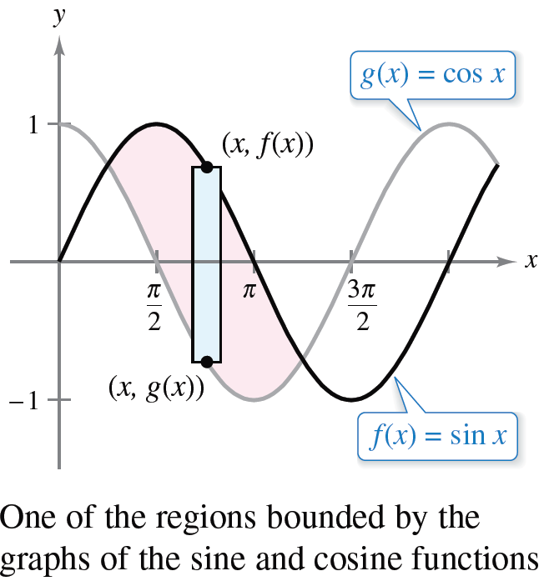
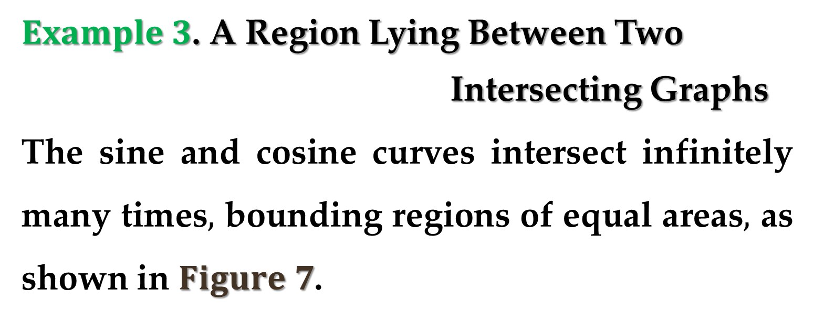
$Example 3$. A Region Lying Between Two
Intersecting Graphs
The sine and cosine curves intersect infinitely many times$,$ bounding regions of equal areas$,$ as shown in $Figure 7$.
Find the area of one of these regions.

Slide 25
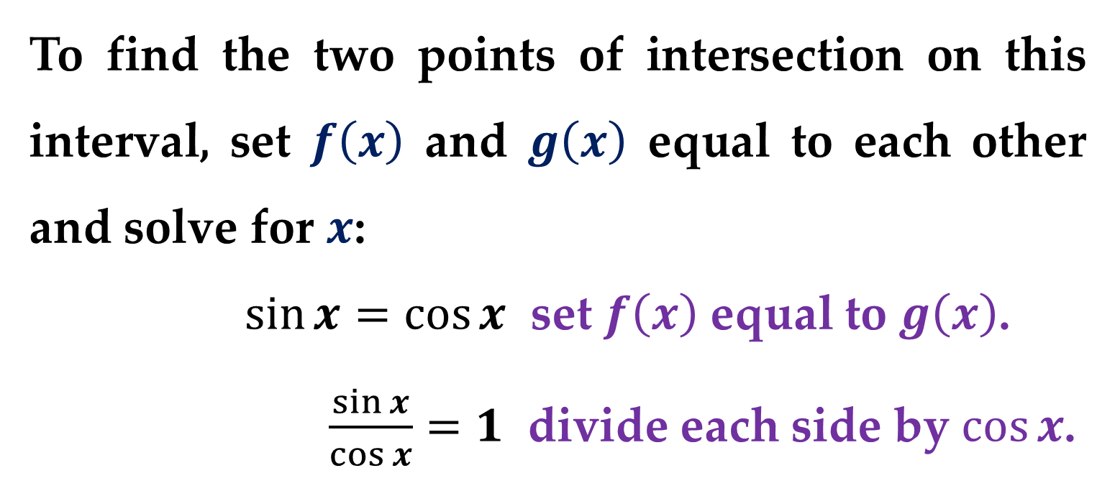
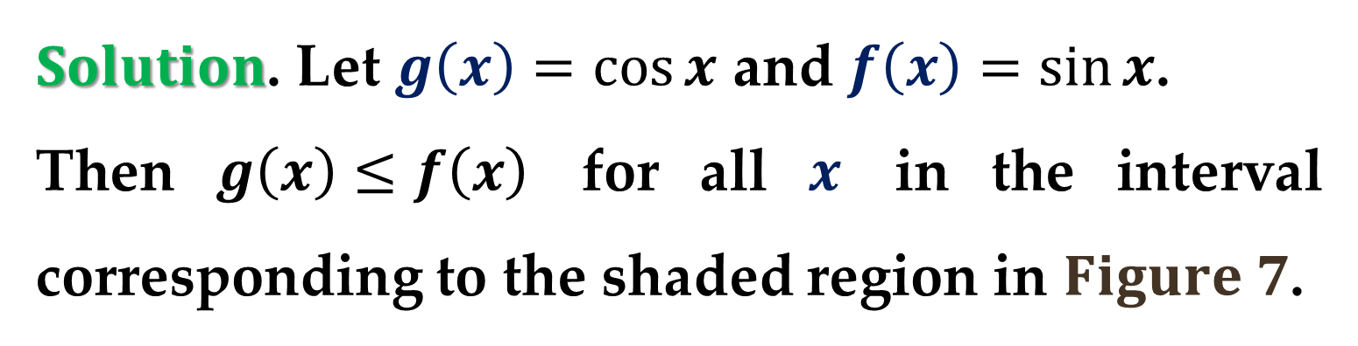
$Solution$. Let $g\left(x\right)=cos⁡x$ and $f\left(x\right)=sin⁡x$.
Then $g\left(x\right)≤f\left(x\right)$ for all $x$ in the interval corresponding to the shaded region in $Figure 7$.
To find the two points of intersection on this interval, set $f\left(x\right)$ and $g\left(x\right)$ equal to each other and solve for $x$:
$\sin{x}=\cos{x}$ set $f\left(x\right)$ equal to $g\left(x\right)$.
$\frac{\sin{x}}{\cos{x}}=1$ divide each side by $\cos{x}$.

Slide 26
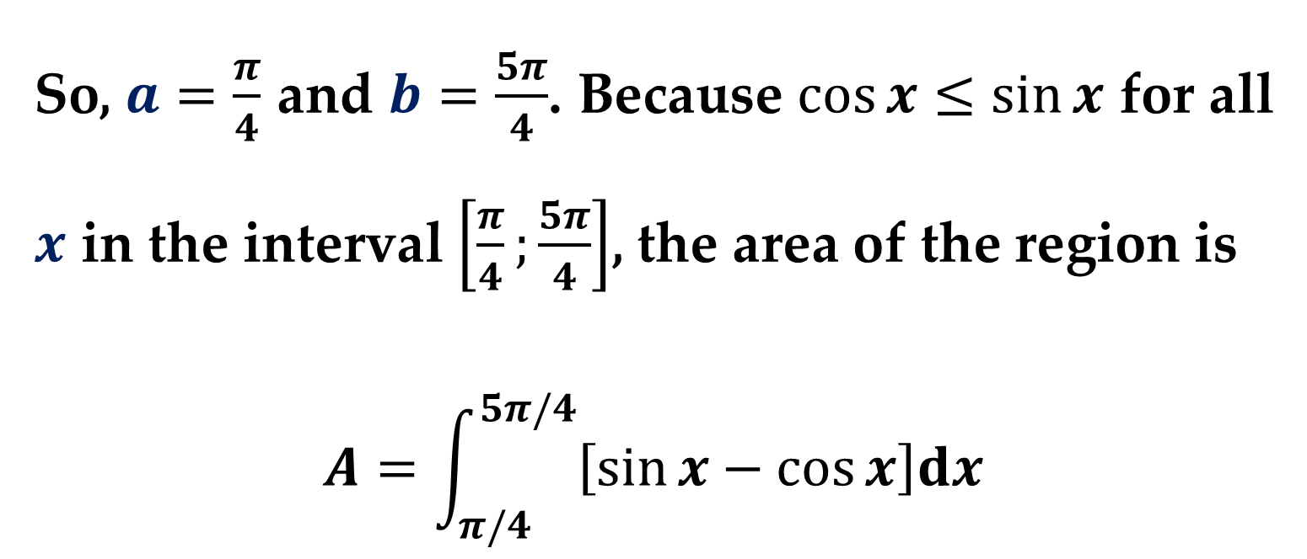
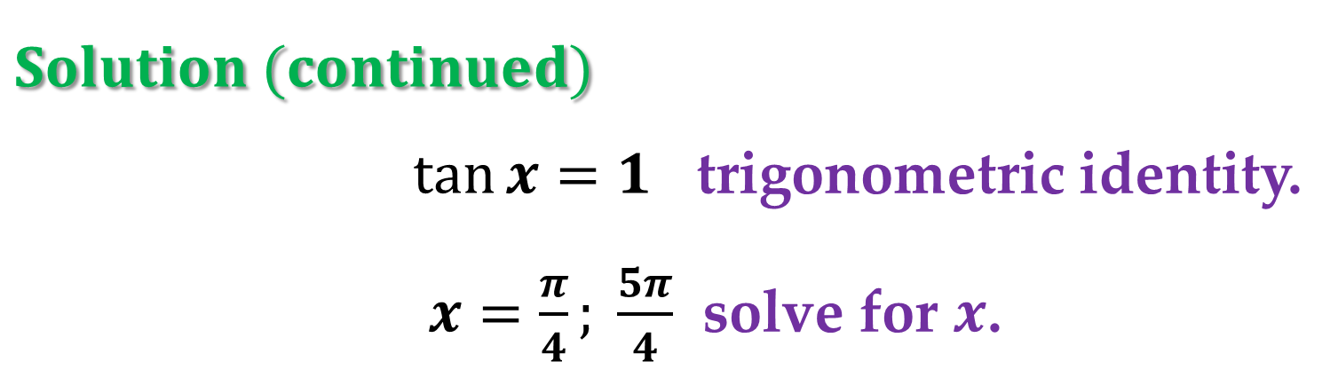
$$Solution (continued)$$
$\tan{x}=1$ trigonometric identity.
$x=\frac{π}{4}; \frac{5π}{4}$ solve for $x$.
So, $a=\frac{π}{4}$ and $b=\frac{5π}{4}$. Because $\cos{x}≤sin⁡x$ for all $x$ in the interval $\left[\frac{π}{4};\frac{5π}{4}\right]$, the area of the region is
$$A=\int_{π/4}^{5π/4}{\left[\sin{x}−\cos{x}\right]dx}$$

Slide 27
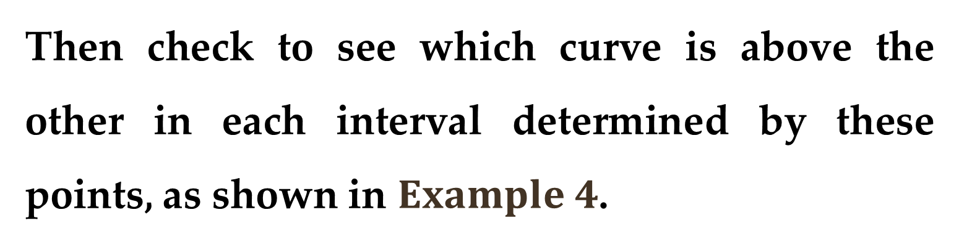
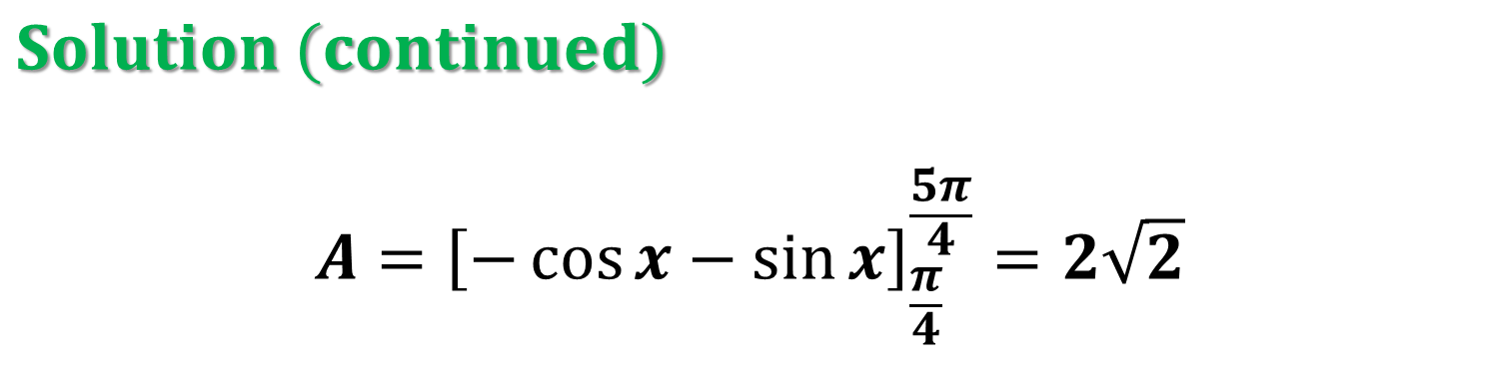
$$Solution (continued)$$
$$A={\left[−\cos{x}−\sin{x}\right]}_{\frac{π}{4}}^{\frac{5π}{4}}=2\sqrt{2}$$
To find the area of the region between two curves that intersect at more than two points, first determine all points of intersection.
Then check to see which curve is above the other in each interval determined by these points, as shown in $Example 4$.

Slide 28
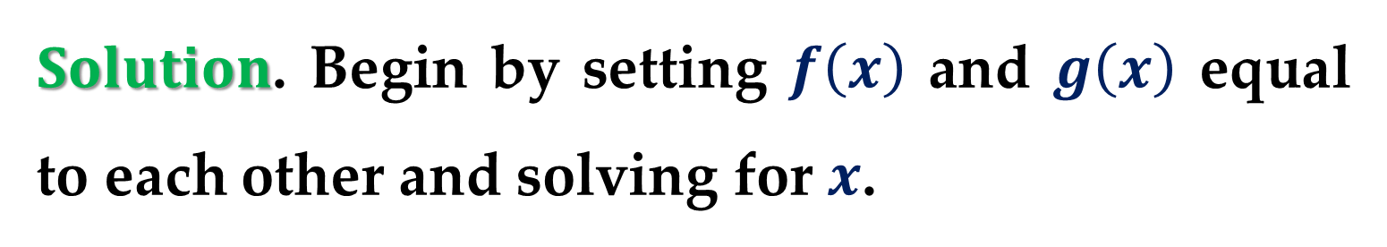
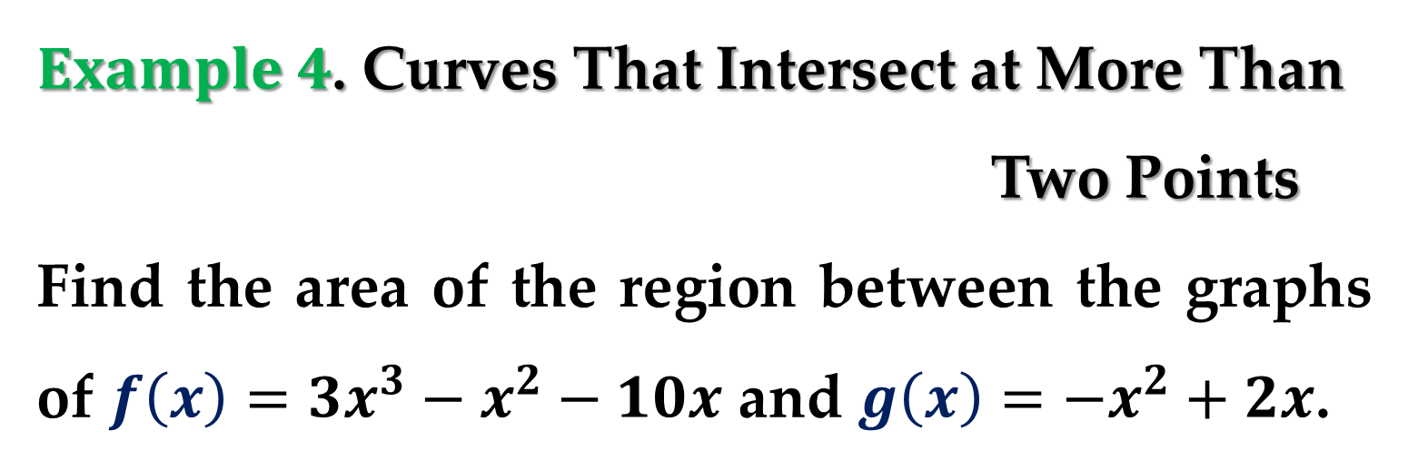
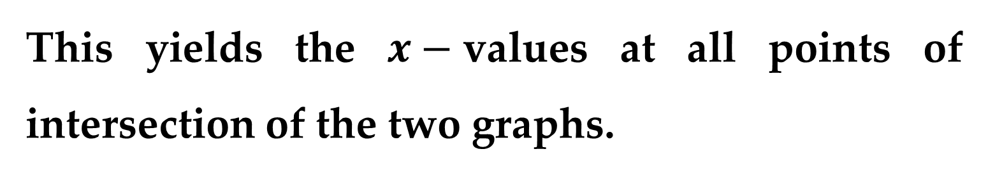
$Example 4$. Curves That Intersect at More Than
Two Points
Find the area of the region between the graphs of $f\left(x\right)=3x^{3}−x^{2}−10x$ and $g\left(x\right)=−x^{2}+2x$.
$Solution$. Begin by setting $f\left(x\right)$ and $g\left(x\right)$ equal to each other and solving for $x$.
This yields the $x−$values at all points of intersection of the two graphs.

Slide 29
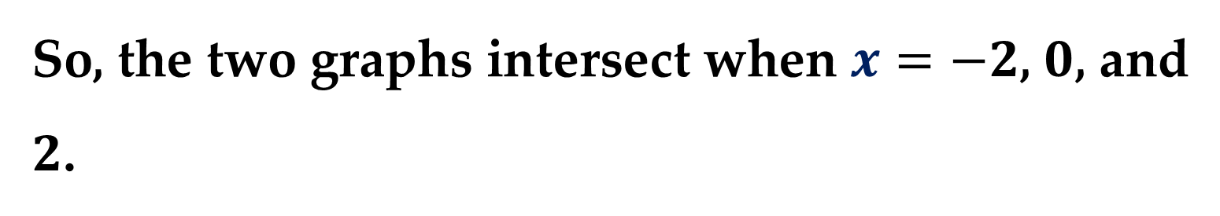
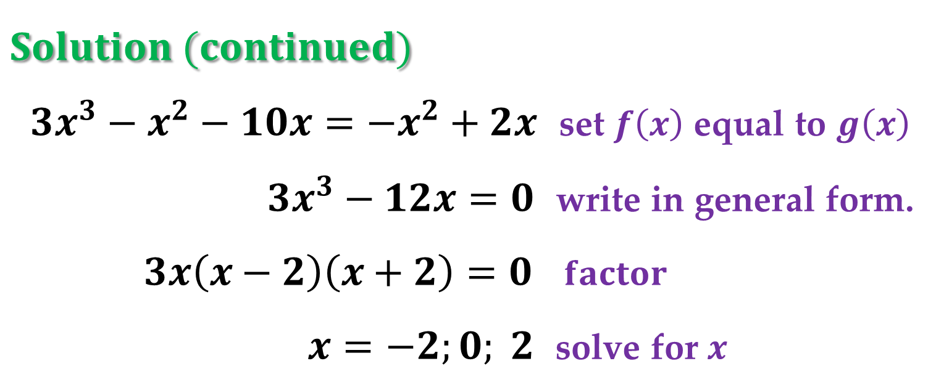

$$Solution (continued)$$
$3x^{3}−x^{2}−10x=−x^{2}+2x$ set $f\left(x\right)$ equal to $g\left(x\right)$
$3x^{3}−12x=0$ write in general form.
$3x\left(x−2\right)\left(x+2\right)=0$ $factor$
$x=−2;0; 2$ solve for $x$
So, the two graphs intersect when $x=−2$, $0$, and $2$.
In $Figure 8$ below, notice that $g\left(x\right)≤f\left(x\right)$ on the interval $\left[−2, 0\right]$.

Slide 30



$$Solution (continued)$$
The two graphs switch at
the origin, however, and
$f\left(x\right)≤g\left(x\right)$ on the
interval $\left[0, 2\right]$.
So, we need two integrals — one for the interval $\left[−2, 0\right]$ and one for the interval $\left[0, 2\right]$.

Slide 31



$$Solution (continued)$$
$$A=\int_{−2}^{0}{\left[f\left(x\right)−g\left(x\right)\right]dx}+\int_{0}^{2}{\left[g\left(x\right)−f\left(x\right)\right]dx}$$
$$=\int_{−2}^{0}{\left[3x^{3}−12x\right]dx}+\int_{0}^{2}{\left[12x−3x^{3}\right]dx}$$
$$={\left[\frac{3x^{4}}{4}−6x^{2}\right]}_{−2}^{0}+{\left[6x^{2}−\frac{3x^{4}}{4}\right]}_{0}^{2}$$

Slide 32



$$Solution (continued)$$
$$=−\left(12−24\right)+\left(−12+24\right)=24$$
In $Example 4,$ notice that you obtain an incorrect result if you integrate from $−2$ to $2$.
Such integration produces $0$ ($verify$).
When the graph of a function of $y$ is a boundary of a region, it is often convenient to use representative rectangles that are horizontal and find the area by integrating with respect to $y$.

Slide 33


In general$,$ to determine the area between two curves$,$ we can use
$$A=\int_{x_{1}}^{x_{2}}{\underset{in variable x}{\underbrace{\left[\left(top_curve\right)−\left(bottom_curve\right)\right]}}}dx$$
$$A=\int_{y_{1}}^{y_{2}}{\underset{in variable y}{\underbrace{\left[\left(right_curve\right)−\left(left_curve\right)\right]}}}dy$$
Here $(x_{1},y_{1})$ and $\left(x_{2},y_{2}\right)$ are either adjacent points of intersection of the two curves involved or points on the specified boundary lines.

Slide 34



$Example 5$. Horizontal Representative
Rectangles
Find the area of the region bounded by the graphs of $x=3−y^{2}$ and $x=y+1$.
$Solution$. Consider
$g\left(y\right)=3−y^{2}$ and $f\left(y\right)=y+1$
These two curves intersect when $y=−2$ and $y=1$, as shown in $Figure 9$ below.

Slide 35



$$Solution (continued)$$
Because $f\left(y\right)≤g\left(y\right)$ on this interval, you have
$$A=\int_{−2}^{1}{\left[g\left(y\right)−f\left(y\right)\right]dy}$$
$$=\int_{−2}^{1}{\left[2−y^{2}−y\right]dy}$$

Slide 36



$$Solution (continued)$$
$$={\left[−\frac{y^{3}}{3}−\frac{y^{2}}{2}+2y\right]}_{−2}^{1}=\frac{9}{2}$$
In $Example 5,$ notice that by integrating with respect to $y$ you need only one integral.
If you had integrated with respect to $x,$ you would have needed two integrals because the upper boundary would have changed at $x=2$ as shown in $Figure 10$.

Slide 37



$$Solution (continued)$$
$$A=\int_{−1}^{2}{\left[\left(x−1\right)+\sqrt{3−x}\right]dx}+$$
$$+\int_{2}^{3}{\left[\sqrt{3−x}+\sqrt{3−x}\right]dx}$$
This integration involves more computations than with respect to $y$.
$$∗∗∗$$

Slide 38

$$Solution (continued)$$
$$A_{1}=\int_{−1}^{2}{\left[\left(x−1\right)+\sqrt{3−x}\right]dx}=$$
$$=\int_{−1}^{2}{\left(x−1\right)dx}+\int_{−1}^{2}{\sqrt{3−x}}dx=$$
$${\left[\frac{x^{2}}{2}−x\right]}_{−1}^{2}+{\left[−\frac{2}{3}{\left(3−x\right)}^{\frac{3}{2}}\right]}_{−1}^{2}$$
$$A_{2}=2\int_{2}^{3}{\left[\sqrt{3−x}\right]dx}={\left[−\frac{4}{3}{\left(3−x\right)}^{\frac{3}{2}}\right]}_{2}^{3}$$
$$A=A_{1}+A_{2}=−\frac{3}{2}+4.\left(6\right)+1.\left(3\right)=4.5=\frac{9}{2}$$

Slide 39
Applications of Integration:
Integration as an Accumulation Process

Slide 40
In this section, the integration formula for the area between two curves was developed by using a rectangle as the representative element.
For each new application of integration in the coming lectures, an appropriate representative element will be constructed using precalculus formulas you already know.

Slide 41


Each integration formula will then be obtained by summing or accumulating these representative elements.
For example, the area formula in this section was developed as follows.

Slide 42


$Example 6$. Describing Integration as an
Accumulation Process
Find the area of the region bounded by the graph of $y=4−x^{2}$ and the $x−$axis. Describe the integration as an accumulation process.
$Solution$. The area of the region is
$$A=\int_{−2}^{2}{\left(4−x^{2}\right)dx}$$

Slide 43


$$Solution (continued)$$
You can think of the integration as an accumulation of the areas of the rectangles formed as the representative rectangle slides from $x=−2$ to $x=2$, as shown in $Figure 11$.

Slide 44


$Solution (continued)$ $Figure 11$.

Slide 45
Applications of Integration:
Least Squares Approximations

Slide 46


Many problems in the physical sciences and engineering involve an approximation of a function $f$ by another function $g$.
If $f$ is in $C\left(\left[a,b\right]\right)$ – the inner product space of all continuous functions on $[a,b]$ – then usually $g$ is chosen from a subspace $W⊂C[a,b]$.

Slide 47

For instance$,$ to approximate the function
$$f\left(x\right)=e^{x} \left(0≤x≤1\right)$$
you could choose one of the following forms of $g$:
$1.$ $g\left(x\right)=a_{0}+a_{1}x, x∈\left[0,1\right];$
$2.$ $g\left(x\right)=a_{0}+a_{1}x+a_{2}x^{2}, x∈\left[0,1\right];$
$3.$ $g\left(x\right)=a_{0}+a_{1}\cos{x}+a_{2}\sin{x}, x∈\left[0,1\right];$

Slide 48


Before discussing ways of finding the function
$g,$ you must define how one function can $“best”$ approximate another function.
One natural way would require the area bounded by the graphs of $f$ and $g$ on the interval $[a,b]$
$$Area=\int_{a}^{b}{\left|f\left(x\right)−g(x)\right|dx}$$
to be a minimum with respect to other functions in the subspace $W$.

Slide 49



This is shown in the next $Figure$:
But because integrands involving an absolute value are often difficult to evaluate$,$ it is more common to square the integrand to obtain
$$I=\int_{a}^{b}{{\left[f\left(x\right)−g\left(x\right)\right]}^{2}dx}$$

Slide 50

Definition
Let $f$ be continuous on $\left[a,b\right],$ and let $W$ be a subspace of $C\left(\left[a,b\right]\right)$.
A function $g∈W$ is called a least squares approximation of $f$ with respect to $W$ if the value of the definite integral
$$I=\int_{a}^{b}{{\left[f\left(x\right)−g\left(x\right)\right]}^{2}dx}$$
is a minimum with respect to all other functions in $W$.

Slide 51


With this criterion$,$ the function $g$ is called the
$least squares approximation$ of $f$ with respect to the inner product space $W$.
Remark
If the subspace $W$ in this definition is the entire space $C\left(\left[a,b\right]\right),$ then $g\left(x\right)=f\left(x\right),$ which implies that $I=0$.

Slide 52

$Example 7$. Finding a Least Squares
Approximation
Find the least squares approximation
$$g\left(x\right)=a+bx$$
for
$$f\left(x\right)=e^{x}, x∈[0,1]$$

Slide 53

$$I=\int_{0}^{1}{{\left[e^{x}−\left(a+bx\right)\right]}^{2}dx}$$
$$=\int_{0}^{1}{e^{2x}dx}−2\int_{0}^{1}{e^{x}\left(a+bx\right)dx}+\int_{0}^{1}{{\left(a+bx\right)}^{2}dx}$$
$$I_{1}=\int_{0}^{1}{e^{2x}dx}={\left.\frac{1}{2}e^{2x}\right|}_{0}^{1}=\frac{1}{2}e^{2}−\frac{1}{2}$$
$$I_{3}=\int_{0}^{1}{{\left(a+bx\right)}^{2}dx}={\left.\frac{1}{3b}{\left(a+bx\right)}^{3}\right|}_{0}^{1}$$

Slide 54

$$I_{3}=\frac{1}{3b}{\left(a+b\right)}^{3}−\frac{1}{3b}a^{3}$$
$$I_{2}=\int_{0}^{1}{\left(a+bx\right)d\left[e^{x}\right]}={\left.e^{x}\left(a+bx\right)\right|}_{0}^{1}−$$
$$−b\int_{0}^{1}{e^{x}dx}=e\left(a+b\right)−a−b{\left.e^{x}\right|}_{0}^{1}$$
$$=e\left(a+b\right)−a−be+b=$$
$$=ea+b−a$$

Slide 55

$$I=I_{1}−2I_{2}+I_{3}$$
$$=\frac{1}{2}e^{2}−\frac{1}{2}−2\left(ea+b−a\right)+\frac{1}{3b}{\left(a+b\right)}^{3}−\frac{1}{3b}a^{3}$$
$$I=a^{2}+ab+\frac{b^{2}}{3}−2ea+2a−2b+\frac{1}{2}e^{2}−\frac{1}{2}$$
$$\frac{∂I}{∂a}=2a+b=2e−2$$
$$\frac{∂I}{∂b}=a+\frac{2}{3}b=2$$

Slide 56

$$2a+b=2e−2$$
$$a+\frac{2}{3}b=2$$
$$a=0.8731$$
$$b=1.6903$$
$$g_{LS}\left(x\right)=0.8731+1.6903 x$$

Slide 57


Of course, the approximation obtained in $Example 7$ depends on the definition of the best approximation.
For instance$,$ if the definition of $“best”$ had been the Taylor polynomial of degree $1$ centered at $0.5,$ then the approximating function would have been
$$g_{T}\left(x\right)≈0.824+1.649x$$
$∗∗∗$

Slide 58

$Example 7$.
$$f\left(x\right)=e^{x}$$
$$g\left(x\right)=f\left(0.5\right)+f^{′}\left(0.5\right)\left(x−0.5\right)$$
$$=1.6487+\left(x−0.5\right)1.6487=$$
$$=1.6487x+0.8244$$

Slide 59


Moreover$,$ the function $g$ obtained in $Example 7$ is only the best $linear approximation$ of $f$ (according to the least squares criterion).
$Example 8$. Finding a Least Squares
Approximation
Find the least squares approximation
$$g\left(x\right)=a+bx+cx^{2}$$
for $f\left(x\right)=e^{x}, x∈\left[0,1\right]$.
$$∗∗∗$$

Slide 60
Thank you for attention

